Slide 1
PSYCHOLOGY CLASS
CHAPTER- PERSONALITY
TOPICS: CARL ROGER’S HUMANISTIC THEORY
CLASS: XII
DATE: 02.07.2020

Slide 2
CARL ROGER’S HUMANISTIC THEORY
Carl Roger was a humanistic psychologist who agreed with the main assumptions of Abraham Maslow.
Roger added that a person to ‘grow’ needs an environment that provides them with acceptance, genuineness and empathy.
Roger believed that humans have one basic motive, that is the tendency to self actualize, i.e., to fulfil one’s potential and achieve the highest level of human – beingness.

Slide 3
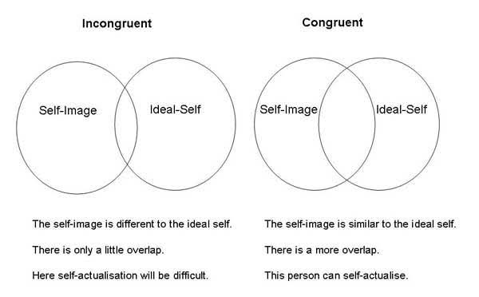
Carl Roger believed that for a person to achieve self- actualization they must be ina state of congruence.
This means that the person’s ideal self should be conguent to his actual behaviour (self-image).

Slide 4
Roger introduced the concept of fully functioning person;
A person who is aware of his/her deepest and innermost feelings and desires. He identified the characteristics of a fully functioning person as:

Slide 5
Openness to experience (both positive and negative)
Existential Living (in touch with different experiences as they occur in life, avoiding prejudging and preconceptions)
Trust feelings
Creativity
Fulfilled life (a person who is happy and satisfied with life).

Slide 6
HOMEWORKS
Discuss the role of home and school in the formation of personality.
Explain the characteristics of Type A, B and C personalities.
What is superego? Discuss the role of superego in personality development.
Explain:
Oral Stage
Id
Trait theory

Slide 7
THANK YOU

